Slide 1
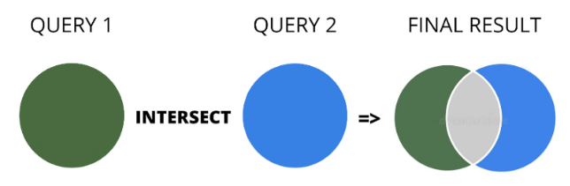
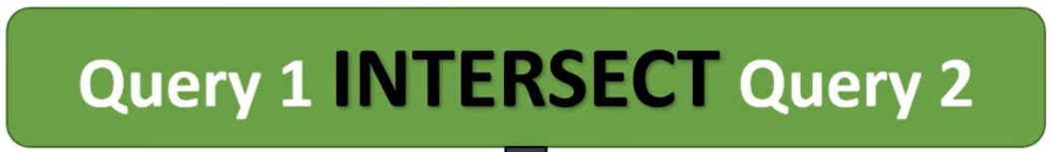

Slide 2
Ex 01: Common IDs with Conditions (Using INTERSECT with WHERE Clause)

Slide 3
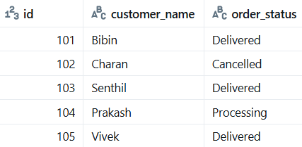
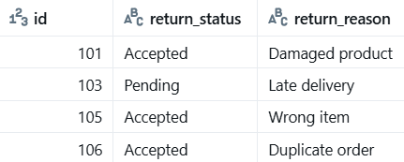


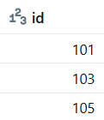
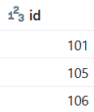
tbl_intersect_orders
tbl_intersect_returns

Slide 4
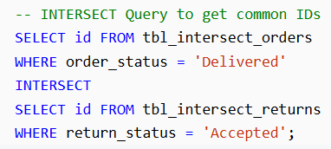
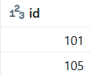

Slide 5
Ex 02: INTERSECT with BETWEEN Operator

Slide 6
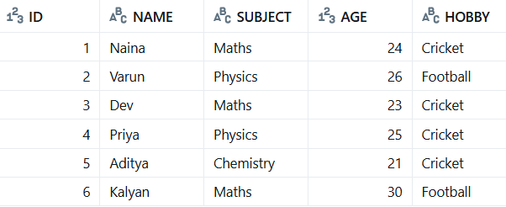
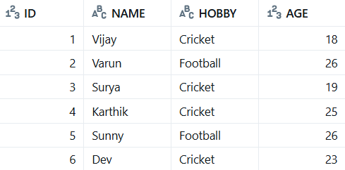

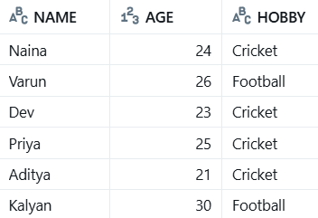
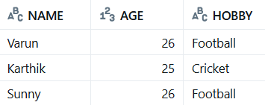
tbl_intersect_students
tbl_intersect_students_hobby

Slide 7
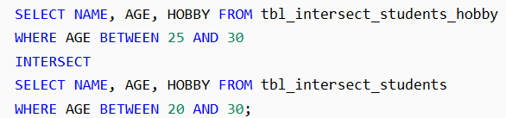


Slide 8
Ex 03: INTERSECT with IN Operator

Slide 9

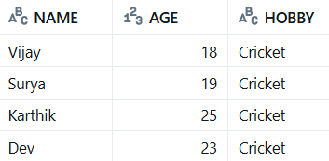
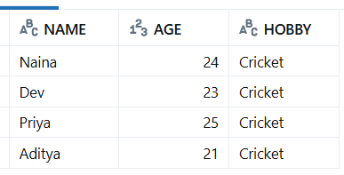
tbl_intersect_students_hobby
tbl_intersect_students
OUTER QUERY
OUTER QUERY
INNER QUERY
INNER QUERY

Slide 10
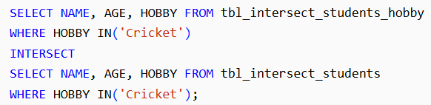

OUTER QUERY
OUTER QUERY
INNER QUERY
INNER QUERY

Slide 11
Ex 04: INTERSECT with LIKE Operator

Slide 12

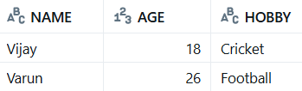

tbl_intersect_students_hobby
tbl_intersect_students

Slide 13
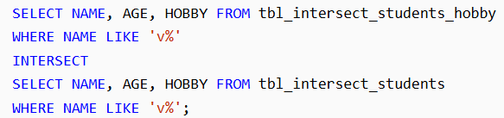


Slide 14
Ex 05: INTERSECT Inside a View or Subquery

Slide 15
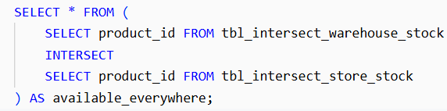
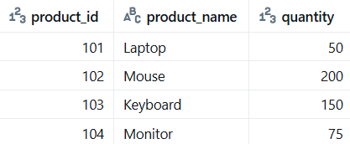
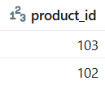
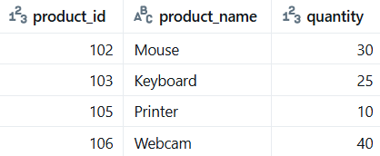
tbl_intersect_warehouse_stock
tbl_intersect_store_stock

